Slide 1
Mobile App for Direct Market Access for Farmers
FINAL VIVA VOICE
Batch Number: CIT-G01
Under the Supervision of,
Ms. BHAVYA B
Assistant Professor
Presidency School of Computer Science and Engineering
Roll Number | Student Name
20211CIT0049 | LAKKI REDDY VARSHITHA
20211CIT0052 | ERANTI SAI KISHAN
20211CIT0053 | ERANTI SAI DINESH
20211CIT0067 | PAVANI M
Name of the Program: B.Tech CSE (Internet Of Things)
Name of the HoD: Dr. Anandaraj S P
Name of the Program Project Coordinator: Dr. Sharmasth Vali Y
Name of the School Project Coordinators: Dr. Sampath A K / Mr. Md Ziaur Rahman

Slide 2
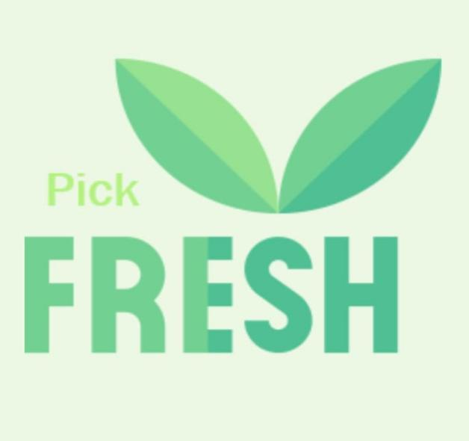
Introduction
Agriculture is the backbone of numerous economies, with sustenance and livelihood for much of the population. Traditional supply chains, however, tend to include several intermediaries, with consumers paying higher costs and farmers getting lower margins. The absence of direct access to markets causes issues like price manipulation, delayed payments, and lack of visibility for small farmers. In order to overcome these issues, this project aims to create an integrated digital platform that fills the gap between consumers and farmers, facilitating direct transactions for produce.
The suggested mobile app is to enable smooth communication between farmers and consumers through providing an easy-to-use interface to buy farm produce directly from the farmers. The site incorporates safe online payment modes, real-time stock updates, and strong user and farmer profile management capabilities. By removing redundant middlemen, the app enables farmers to be paid a decent price for their produce while ensuring consumers get fresh and cheap produce.
One of the platform's essential elements is how administrators contribute to creating trust and credibility in the system. The administrators are charged with bringing verified farmers on board, guaranteeing authenticity and trustworthiness. The administrators are also instrumental in posting and dealing with government or private schemes to favor farmers, thereby giving them a link to monetary and technical aid. This initiative seeks to empower farmers through greater market exposure and simplifying the selling process.

Slide 3
Literature Survey
Sl.no. | Paper Title | Propose model | Results | Drawbacks
1. | Mobile based agricultural Apps and portals for farmers’ welfare in India 2021 | Mobile applications for agricultural information dissemination, such as Kisan Suvidha, providing weather, market prices, and pest control updates. | Improved decision-making: Farmers get real-time weather and market updates, helping them make informed choices. | Limited awareness and digital literacy: Many farmers are unaware of these apps or struggle to use them effectively.
2. | Mobile Based Agricultural Apps and Portals for Farmers’ Welfare in India 2021 | The paper discusses the development of mobile applications and portals to provide farmers with real-time agricultural information, market intelligence, weather forecasts, and advisory services. | Improved trust and traceability in transactions, reducing fraud. | High computational costs and lack of farmer familiarity with block chain technology.
3. | E-Mandi: Digital Marketplace for Farmers 2022 | Digital platform to connect farmers with buyers via a bidding system for agricultural produce. | Enhanced competition leading to better price discovery for farmers. | Requires high internet penetration; limited adoption in areas with low digital literacy.
4. | Agro Connect: AI-Driven Marketplace for Farmers 2022 | AI-powered app recommending optimal prices and connecting farmers to nearby buyers based on demand. | Reduced time to market and better price optimization. | High processing demands and challenges in adapting AI models to regional variations.
5. | Farmers' Direct Selling Mobile App 2023 | Mobile application enabling farmers to list products and directly negotiate prices with consumers. | Simplified selling process and higher profit margins for farmers. | Limited support for logistics and delivery, restricting usability for large-scale operations.

Slide 4
Literature Survey
Sl.no. | Paper Title | Proposed model | results | Draw backs
6. | Mobile Based Agricultural Apps and Portals for Farmers’ Welfare in India 2023 | Blockchain-based supply chain for tracking agricultural produce from farm to market. | Increased transparency, reduced middlemen exploitation. | High energy consumption and complex implementation costs.
7. | Direct Market Access for Farmers 2024 | The research proposes a digital platform that allows farmers to sell their produce directly to buyers, eliminating intermediaries. | The adoption of these mobile applications has improved farmers' access to information, helping them make informed decisions about crop management, pest control, and market prices. | Despite the benefits, limited digital literacy and lack of internet connectivity in rural areas hinder widespread adoption. Additionally, farmers' reliance on traditional farming practices and middlemen remains a challenge
8. | Mobile App for Direct Market Access for Farmers 2024 | The research proposes the development of a mobile application, FarmConnect, to provide farmers with direct market access by connecting them with consumers and retailers. | During alpha testing, the system successfully allowed farmers to list and manage their produce while enabling real-time updates | While the system effectively connected farmers and consumers, it lacks real-time transaction monitoring
9. | Mobile App For Direct Market Access For Farmers 2024 | GPS-Based Direct Market Access App: A mobile application that connects farmers directly with consumers, wholesalers, and retailers, eliminating middlemen and allowing real-time price negotiation. | Improved Market Accessibility: Farmers gain direct access to buyers, increasing profits and reducing dependency on intermediaries. | Limited Digital Infrastructure: Many rural areas lack proper internet connectivity and smartphone access, making adoption challenging.

Slide 5
RESEARCH GAPS
The key research gaps for our project are mentioned below:
Limited Real-Time Location Accuracy: The effectiveness of location-based alerts depends on the accuracy and reliability of GPS services, which may vary due to environmental or technical constraints.
Multilingual Interface Limitations: While multiple language options are offered, the depth of linguistic and cultural nuance handling, especially for local dialects or slang, is often insufficient.
Lack of Personalization in Product Recommendations: The system may not utilize advanced data analytics or AI to tailor suggestions based on user preferences, purchase history, or location trends.
User Interface Accessibility for Diverse Demographics: Rural or elderly users may face challenges navigating the app, pointing to a gap in inclusive UI/UX design adapted for all user groups.
Inadequate Seller Verification Mechanism: There may be limited provisions for verifying the authenticity and credibility of sellers, which could affect trust and user satisfaction.
Real-time Communication Challenges: The system's ability to support seamless real-time messaging or voice communication across language barriers is likely underdeveloped.
Absence of Offline Functionality: The reliance on constant internet connectivity might exclude users in regions with poor or intermittent network access.

Slide 6
Proposed Methodology
The proposed mobile application will act as a one-stop platform providing farmers with:
User Registration and Localization: Users and sellers register with the system, providing details such as name, location, and preferred language. Location services (e.g., GPS) are enabled to detect user and seller positions accurately.
Multi-language Interface: The system supports multiple languages, enabling users and sellers to interact in their preferred language. Auto-translation tools may be integrated for real-time message translation.
Product Discovery Mechanism: Users can search for specific products within their vicinity using filters like category, distance, and seller ratings. Sellers list available products with descriptions and prices.
Request Creation by Users: Users can send product requests to nearby sellers based on search results. Requests include product details, quantity, preferred time, and additional notes.
Seller Response System: Sellers receive incoming product requests via notifications. They can accept, reject, or negotiate requests within the platform.
Proximity-based Notification Trigger: When a seller who has accepted a request comes within a 1 km radius of the user, the system automatically sends a notification to both parties. This is achieved using continuous background location tracking.

Slide 7
Proposed Methodology
Communication and Coordination: A built-in chat or message system facilitates communication, supported by automatic language translation to bridge language barriers.
Transaction and Confirmation: Once the product exchange is completed, both user and seller can confirm the transaction. Optionally, a digital payment feature and review system can be included.
Data Security and Privacy: User and seller data, including location information, are protected with appropriate encryption and privacy policies.

Slide 8
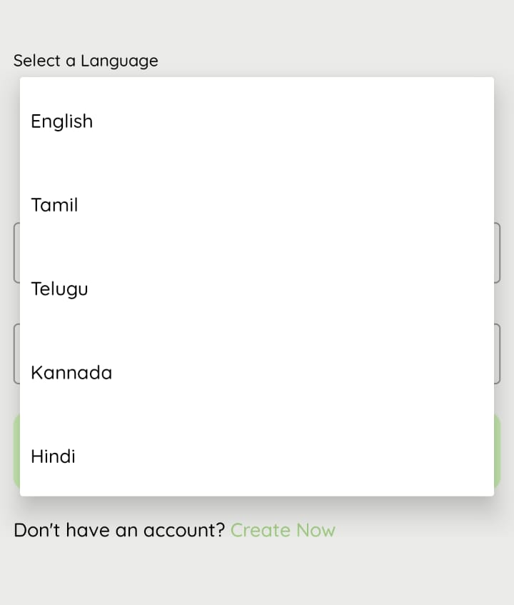
Objectives
The primary objective of the project is to:
Enable Location-Based Discovery of Nearby Sellers: Facilitate users in identifying and connecting with sellers within a 1 km radius using GPS/location services.
Provide Multi-Language Support for Inclusive Communication: Incorporate multiple language options to ensure smooth and effective interaction between users and sellers from diverse linguistic backgrounds.
Implement Real-Time Notifications for Request Acceptance: Notify users instantly when a nearby seller accepts their product request, improving responsiveness and engagement.
Enhance Localized Commerce Through Efficient User-Seller Interaction: Promote local trade by streamlining the communication and transaction process between users and sellers using location-based alerts.

Slide 9
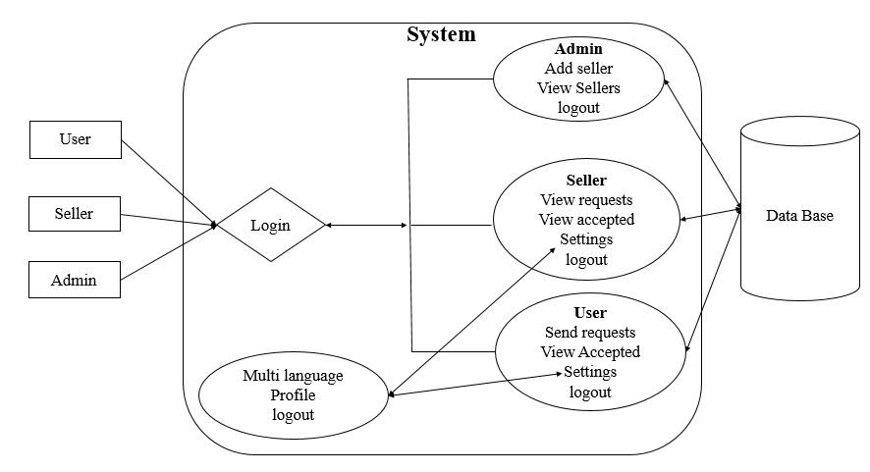
DESIGN ARCHITECTURE AND IMPLEMENTATION DIAGRAM FOR MOBILE APP FOR DIRECT MARKET ACCESS FOR FARMERS

Slide 10
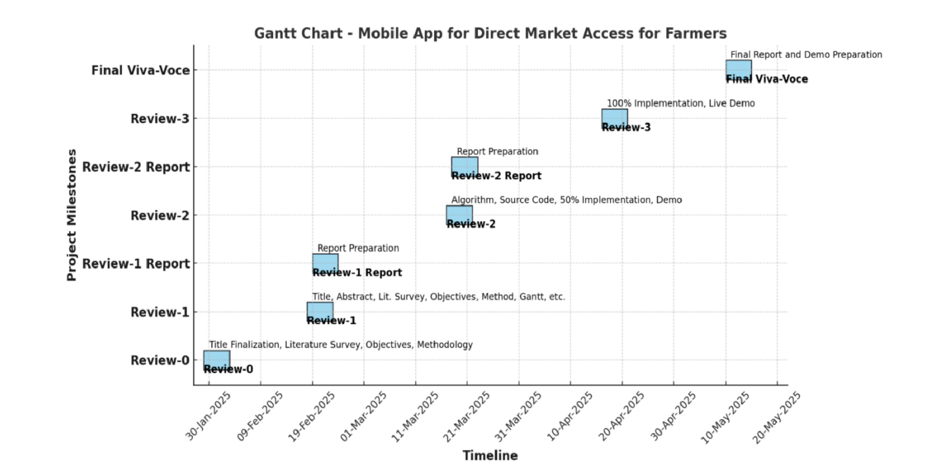
Timeline of Project
Figure: 2 Time Line By Gantt Chart

Slide 11
Expected Outcomes
Enhanced Local Commerce
Efficient Product Request Process
Multilingual Support for Broader Accessibility
Location-Based Seller Notifications
Improved Buyer-Seller Communication
Optimized User Experience Through Proximity Detection
Increased Sales Opportunities for Sellers
User Empowerment and Satisfaction
Bridging the Urban-Rural Market Gap
Scalable Model for Regional Marketplaces

Slide 12
Conclusion
In conclusion, the proposed system significantly enhances local commerce by leveraging location-based technology and multilingual support to create a seamless and inclusive user experience. By allowing users to discover nearby sellers and directly request products, the platform fosters real-time, efficient interactions that are both convenient and practical. The integration of multiple language options ensures broader accessibility, overcoming communication barriers that often hinder transactions in diverse communities. Furthermore, the smart notification system—activated when sellers are within 40 km radius—adds a layer of immediacy and relevance, ensuring timely engagement between buyers and sellers. Overall, this innovative solution bridges the gap between local demand and supply while promoting inclusive, technology-driven market participation.

Slide 13
References:
[1] Chang, H.-H., & Meyerhoefer, C.D. (2020). COVID-19 and the demand for online food shopping services: Empirical evidence from Taiwan. American Journal of Agricultural Economics, 103(2), 448–465. 2020– "Android App to Connect Farmers to Retailers and Food Processing Industry." IEEE Xplore. Available at: https://ieeexplore.ieee.org/document/9034434.
[2]IEEE Xplore. (2020). Android App to Connect Farmers to Retailers and Food Processing Industry. Available at: https://ieeexplore.ieee.org/document/9034434.
[3]Saxena, S., & Limbad, A. (2021). Consumption change of household food habits pre and post lockdown during COVID-19: A perspective study of Gujarat and Maharashtra. Global Journal of Interdisciplinary Studies, 4(1), 16–36.
[4]Zhao, L., Zhang, Y., & Zhang, H. (2022). Research on the impact of digital literacy on farmer households' green cooking energy consumption: Evidence from rural China. International Journal of Environmental Research and Public Health, 19(13464).
[5]Manocha, S., Bhullar, P.S., & Sachdeva, T. (2023). Factors determining the investment behaviour of farmers—The moderating role of socioeconomic demographics. Journal of Indian Business Research.
[6]IEEE Xplore. (2023). Smart Kisan: A Mobile App for Farmers' Assistance in Agricultural Activities. Available at: https://ieeexplore.ieee.org/document/10199471.
[7] Hinojosa, C., Sanchez, K., Camacho, A., & Arguello, H. (2023). AgroTIC: Bridging the gap between farmers, agronomists, and merchants through smartphones and machine learning. arXiv preprint, arXiv:2305.12418. Available at: https://arxiv.org/abs/2305.12418.
[8]Kumar, R. (2023). Farmers' use of the mobile phone for accessing agricultural information in Haryana: An analytical study. Open Information Science. Available at: https://www.degruyter.com/document/doi/10.1515/opis-2023-0031/html.
[9]Agriculture & Food Security. (2023). Is agricultural digitization a reality among smallholder farmers in Sub-Saharan Africa? Unpacking the digital agricultural paradox.
[10]Mdoda, L., Christian, M., & Agbugba, I. (2024). Use of information systems (mobile phone app) for enhancing smallholder farmers' productivity in Eastern Cape Province, South Africa: Implications on food security. Journal of the Knowledge Economy, 15, 1993–2009. Available at: https://link.springer.com/article/10.1007/s13132-024-01478-x.

Slide 14
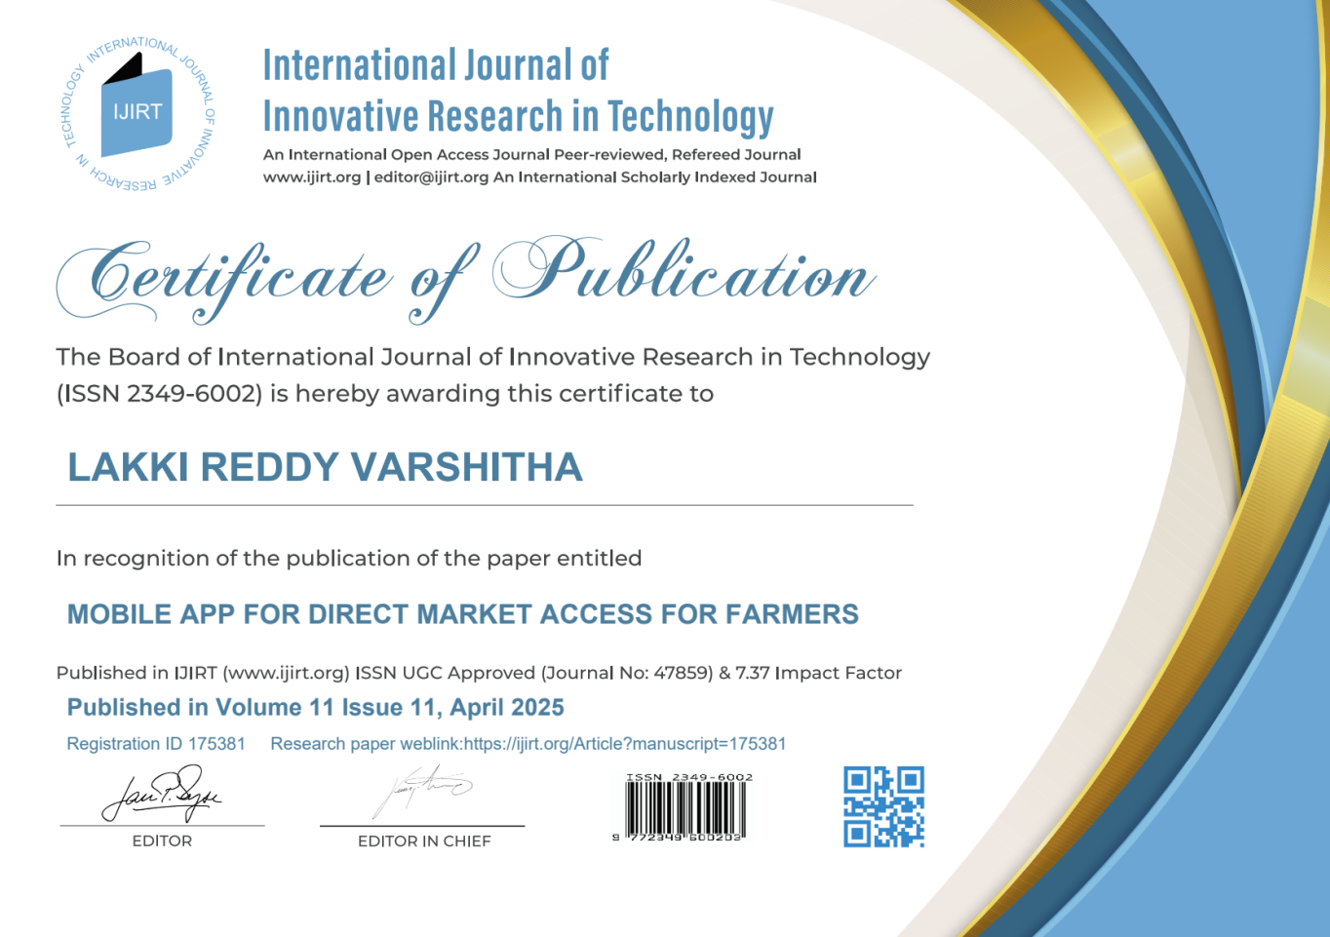
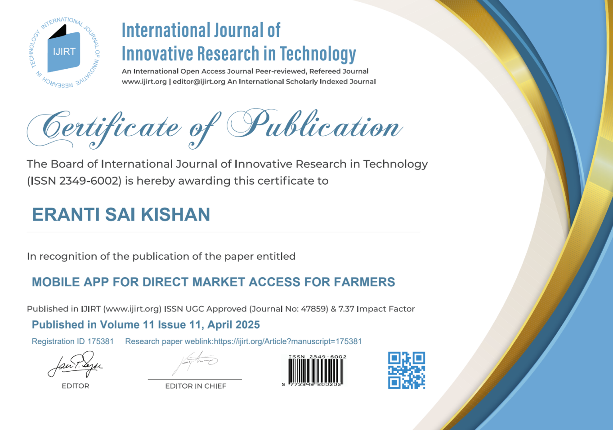
PUBLICATION DETAILS
Below are the certificates of publication in the IJIRT Journal:

Slide 15
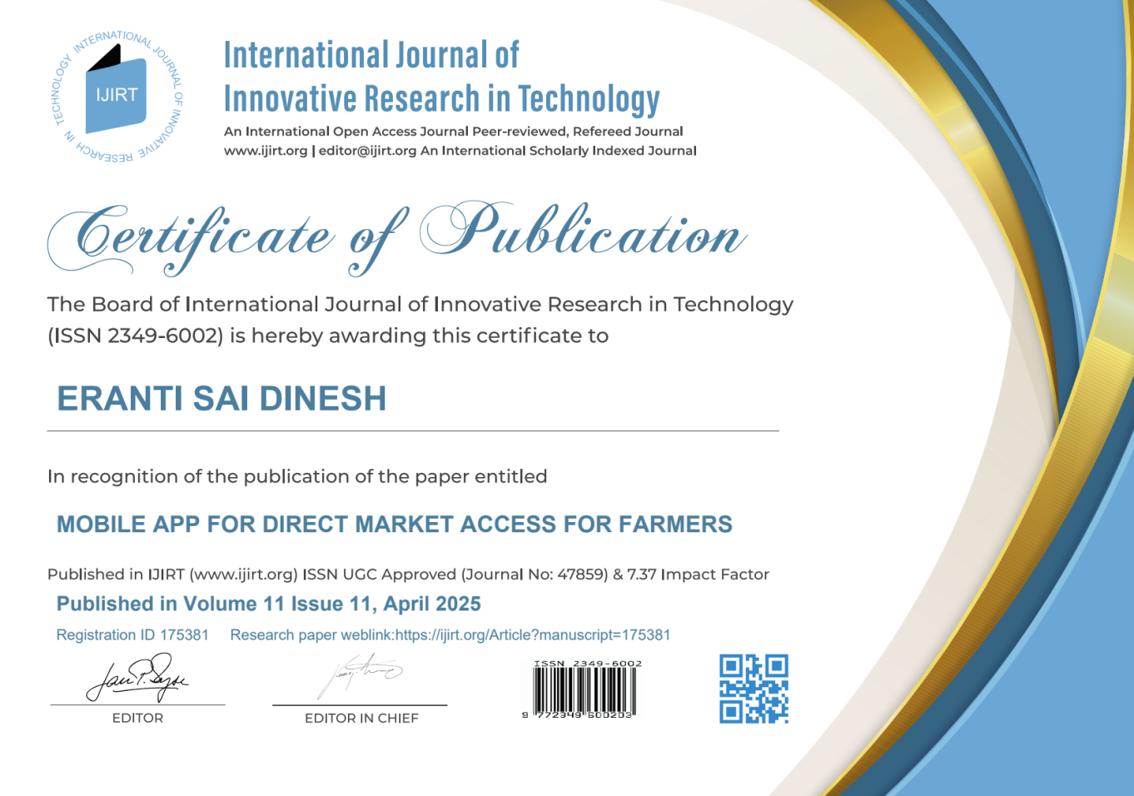
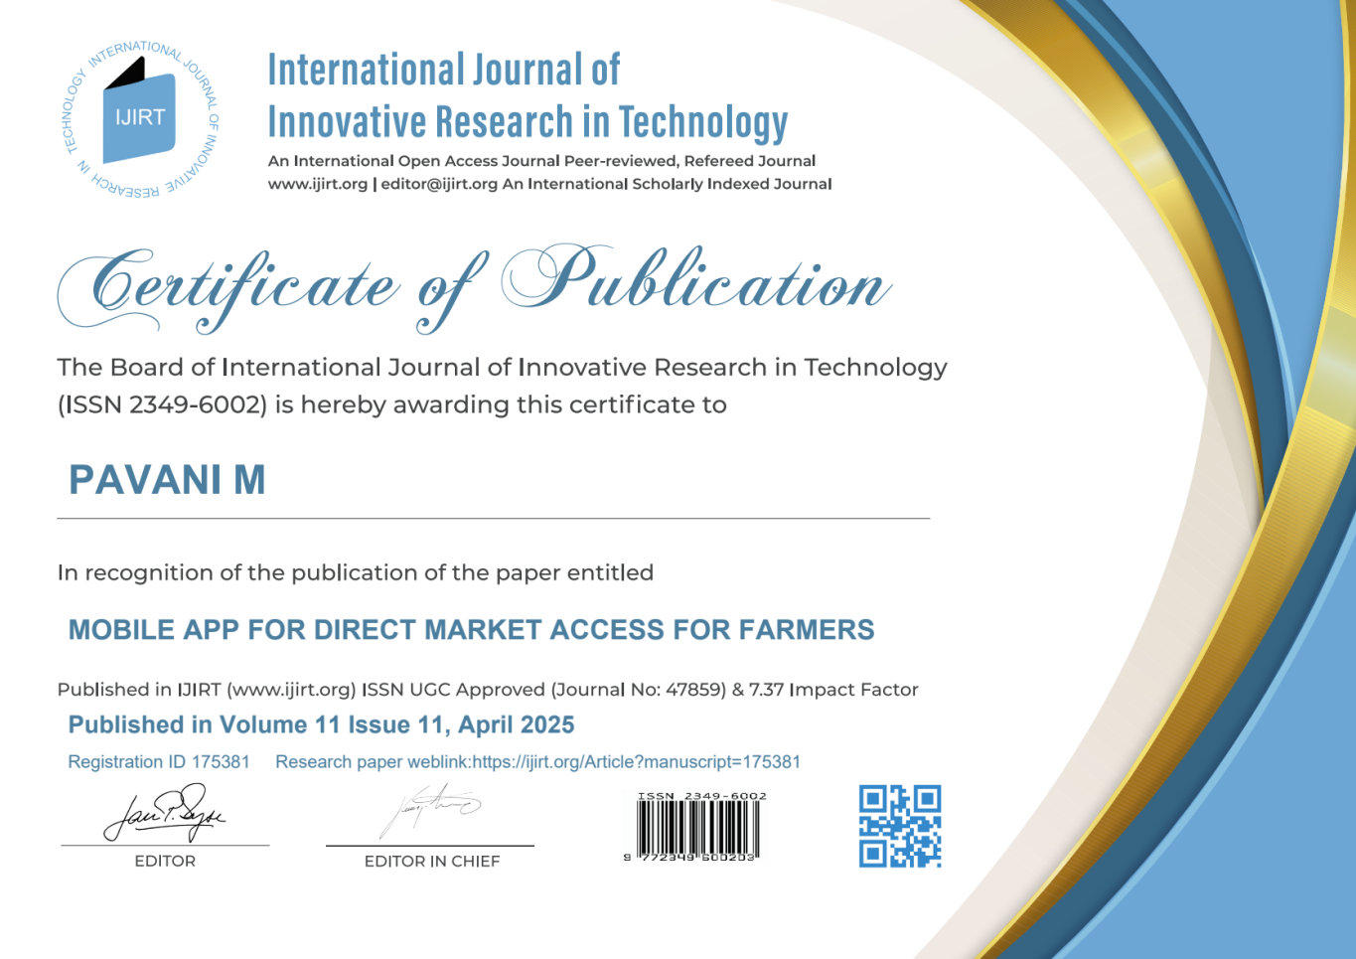
PUBLICATION DETAILS

Slide 16
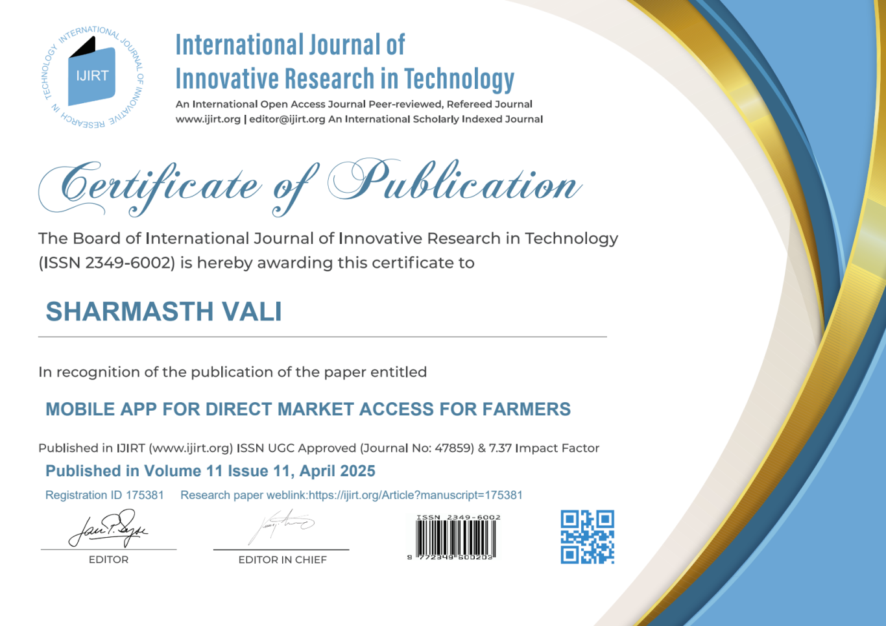
PUBLICATION DETAILS

Slide 17


